Slide 1

Data Management for Synthesis
Matthew B. Jones
Jim Regetz
National Center for Ecological Analysis and Synthesis (NCEAS)
University of California Santa Barbara
NCEAS Synthesis Institute
June 21, 2013
Notes:
NCEAS is an NSF funded research center whose mission is to advance the state of ecological knowledge through synthetic, cross-cutting studies using existing data. Soon after NCEAS formed it became obvious that there was a large need for informatics tools that support synthetic research.

Slide 2
Fri 21 June Schedule
Data management, metadata, and data repositories
Readings: [https://projects.nceas.ucsb.edu/nceas/documents/88]
8:15-8:30 (Disc) Feedback/thoughts on previous day
8:30- 9:15 (Lect) Data Management
9:15-10:15 (Actv) Scientific data repositories: Data discovery and
contribution
10:15-10:45 * Morpho Install and Break *
10:45-11:45 (Tutl) Documenting and Sharing data with Morpho
12:00- 1:00 Lunch Social media with Jai and Jarrett in NCEAS lounge
1:00- 2:00 GP: Data sharing policies
2:00- 2:45 (Disc) Report and discussion: Data sharing policies *
2:45- 3:00 * Break *
3:00- 5:00 GP: Locating, organizing, documenting project data
5:00- 5:15 "The view from the balcony" - []
2
Notes:
In addition to the functional requirements and interAdditional drivers for guiding implementation.
- Scalable

Slide 3
Barriers to Synthesis
Data not preserved
Tiny proportion of ecological data are readily available
Dispersed, isolated repositories
Each community has its own; disconnected; underutilized
Lack of software interoperability
Metacat, DSpace, Mercury, iRODS, XMCat, OPeNDAP, ...
Heterogeneous data
Many data formats, metadata formats, and varying semantics
3
Notes:
In addition to the functional requirements and interAdditional drivers for guiding implementation.
- Scalable

Slide 4
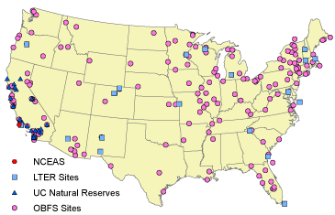
Dispersed data from field stations

Slide 5
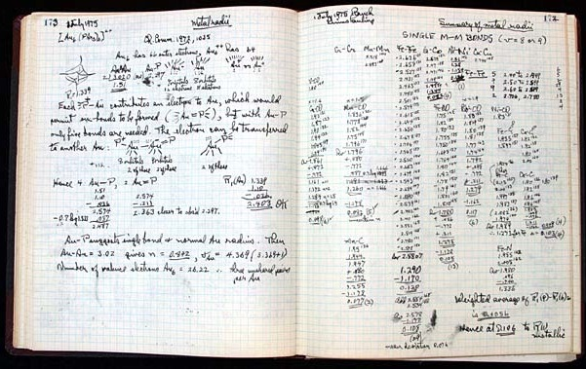
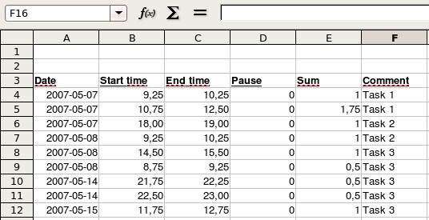
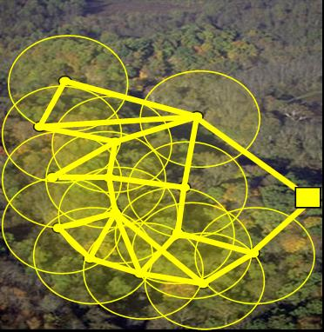
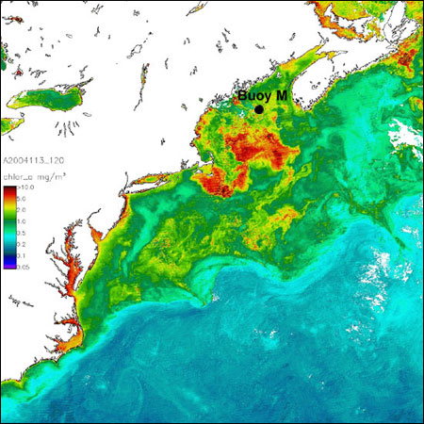
Data diversity
Biological
e.g., Gene, Organism, Population, Species, Community, Biome, Ecosystem
Environmental
e.g., Atmospheric, Chemical, Ecological, Hydrological, Oceanographic, Physical
Social
e.g., Land use, human population
Economic
e.g., trade, ecosystem services, resource extraction
Notes:
Life has many different layers of organization – from the molecules that are the basis of our DNA, to the cells of our body, to the individuals that form populations and then a species. A group of species within a region form communities, and communities form biomes.
Demonstrative slide, not illustrative.
Placement of these concepts is general and still under development. Slide more to show basic scale and complexities, than interdependence.
Natural and human factors can affect all levels. For instance, pollution affects the physical well-being of organisms, thus affecting a population. Certain species might be affected by pollution more than others, changing the composition of communities, and eventually ecosystems. The answers to potential research questions can differ depending on the layer.

Slide 6
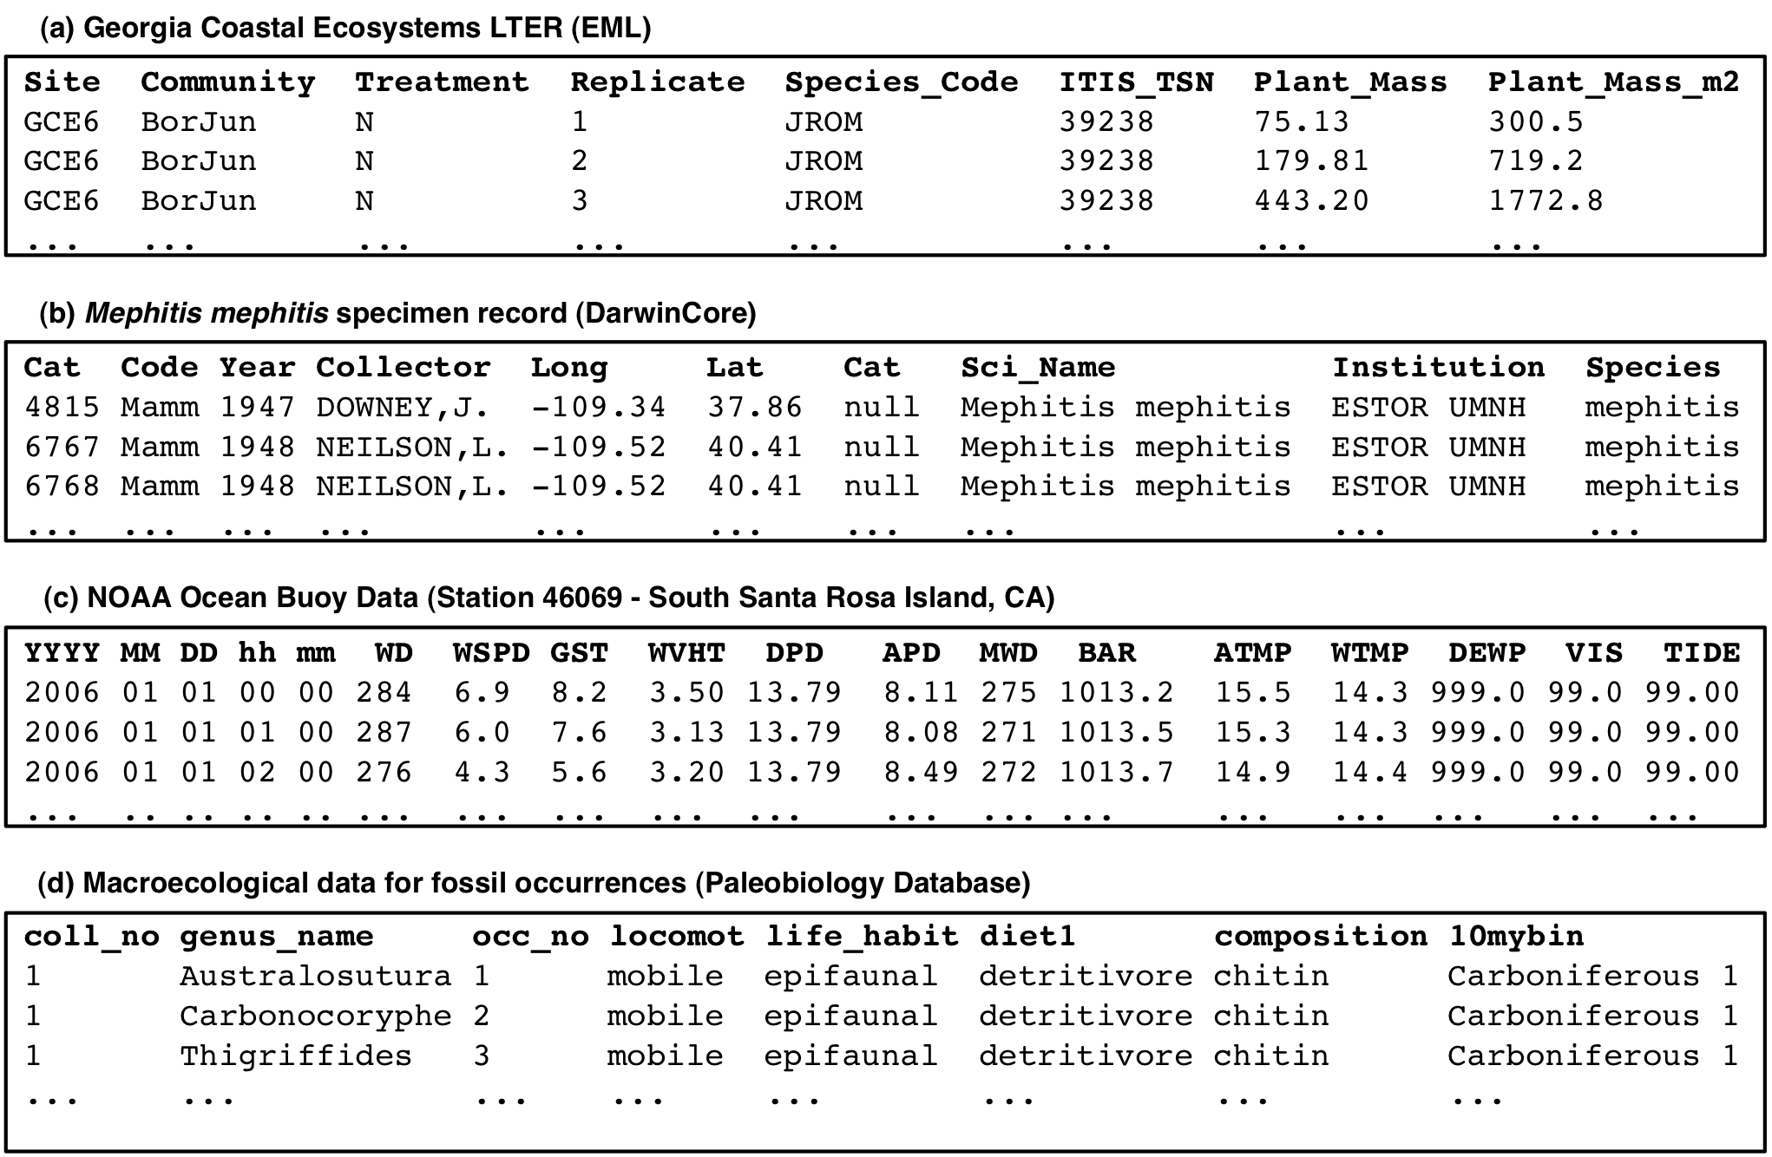
Biodiversity data heterogeneity
Space
Time
Taxa
Notes:
What are the tendencies for the development of informatics tools to support biodiversity conservation?
How these tools may be used to support policy/ decision makers for implementing public policies on biodiversity conservation and management?

Slide 7
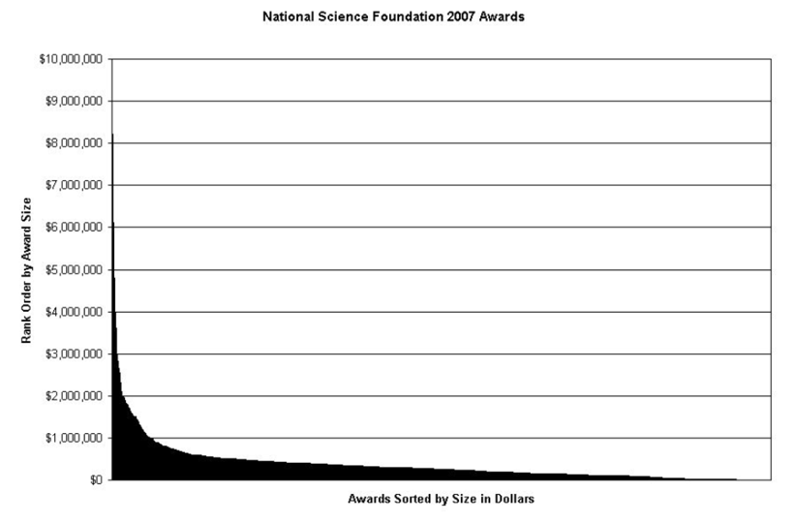
“Dark” data in the long tail
Heidorn, P. 2008. doi:10.1353/lib.0.0036

Slide 8
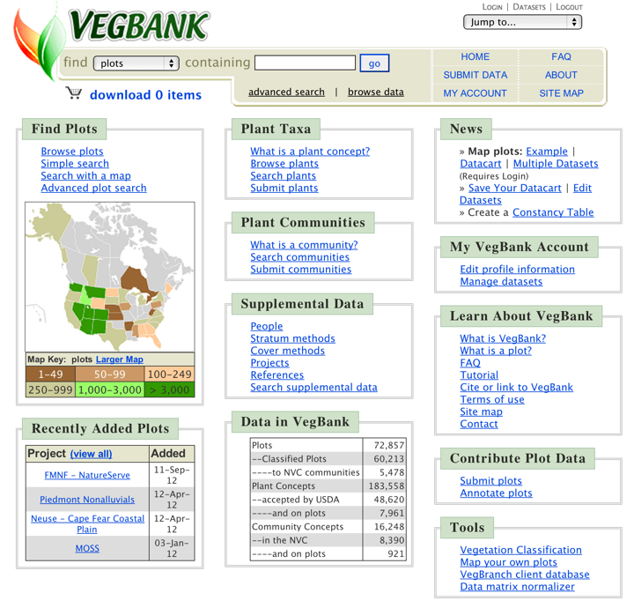
From http://gbif.org

Slide 9








Software diversity
GMN

Slide 10

Data Heterogeneity
Low
Heterogeneity
High
High
Volume
Low
Tight coupling
Simple subsetting
Explicit semantics
Loose coupling
Hard subsetting
Limited semantics

Slide 11

Solutions
Preserve data
Adopt standards
Create networks
Create interoperable software

Slide 12
Preserve Data

Slide 13
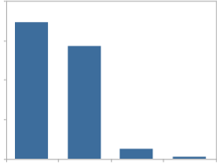
Preserve data in the KNB
Data Types
Ecological
Environmental
Demographic
Social/Legal/Economic
60
Diverse Contributors
Individual investigators
Field stations and networks
Government agencies
Non-profit partnerships
Scientific Societies
Synthesis centers
45
Data
Sizes
%
30
15
0
< 1
1-10
>200
10-200
MB
13

Slide 14
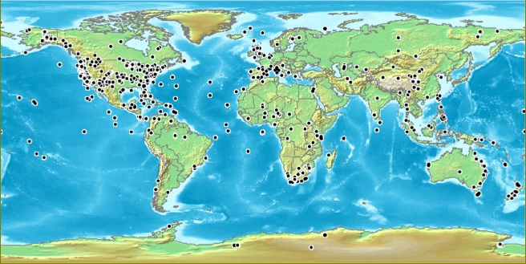
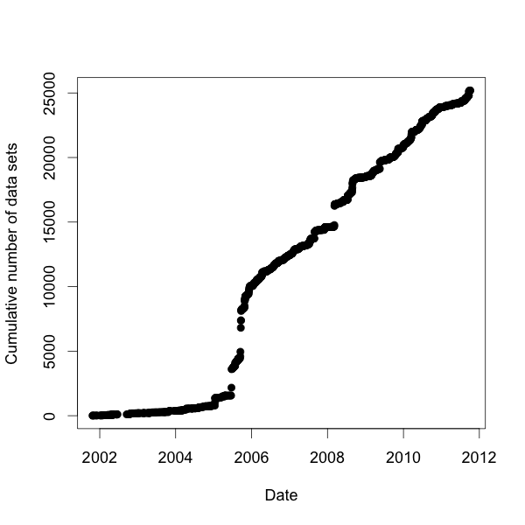
Knowledge Network for Biocomplexity Data Distribution
Total: 25,191 data sets
Data until: 07 Oct 2011

Slide 15
Metacat Data Server
Data and metadata management
Stores, search, and document data
Customizable Web-based search interface
Web metadata entry tool
DOI Support
Runs on Linux, Windows, MacOS
Replication capabilities
Postgres or Oracle backend
OAI-PMH harvester
GPL open source license

Slide 16
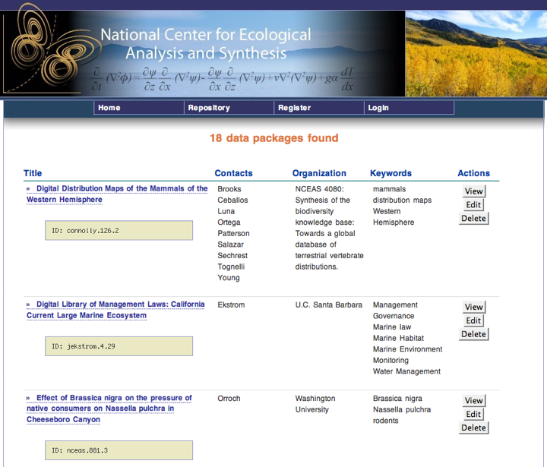
Notes:
Metacat has a configurable web user interface for the catalog, with support for embedding within any web site designs. here we show the NCEAS skin displaying results of a data search.

Slide 17
Adopt STandards

Slide 18
Metadata and data heterogeneity
Every community has
many data schemas
one for each project and person
many data formats
ASCII, NetCDF, HDF, GeoTiff, ...
many metadata schemas
Biological Data Profile, Darwin Core, Dublin Core, Ecological Metadata Language (EML), Open GIS schemas, ISO Schemas, ...
Accepting this heterogeneity is critical

Slide 19
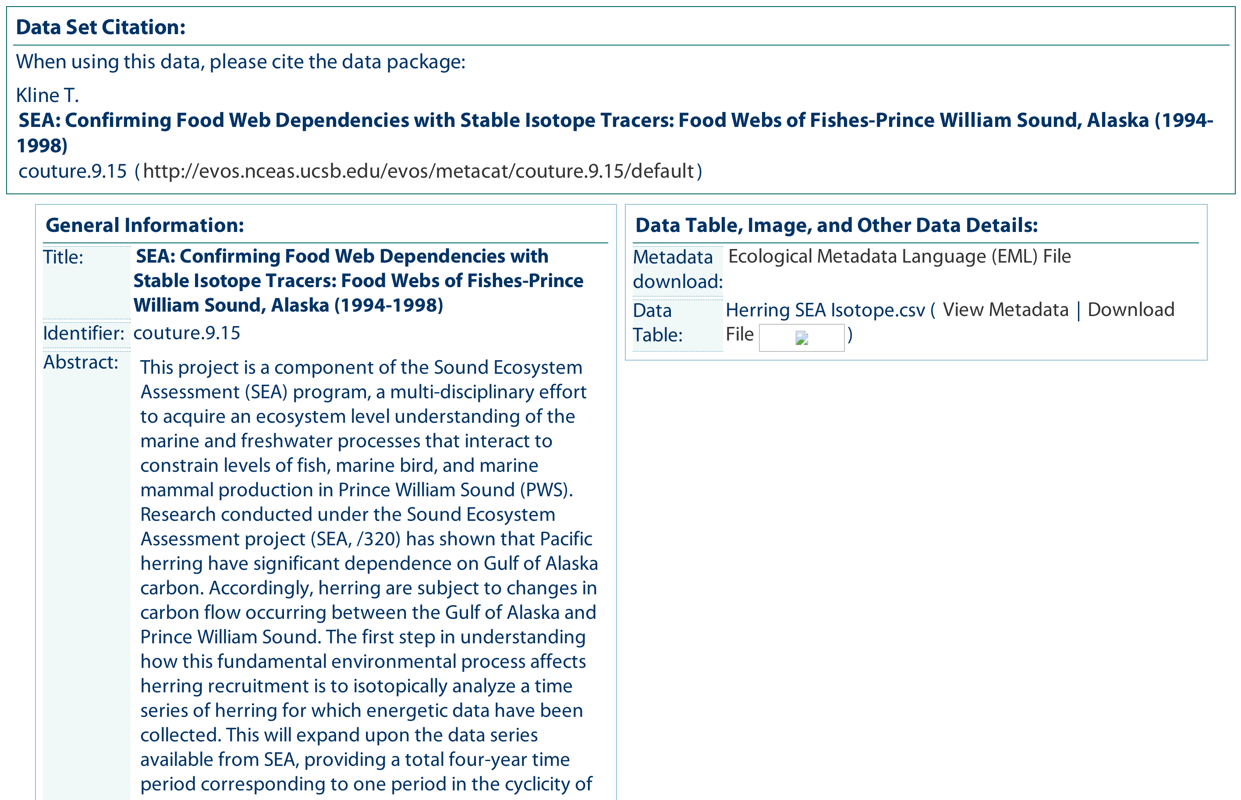
Metadata

Slide 20
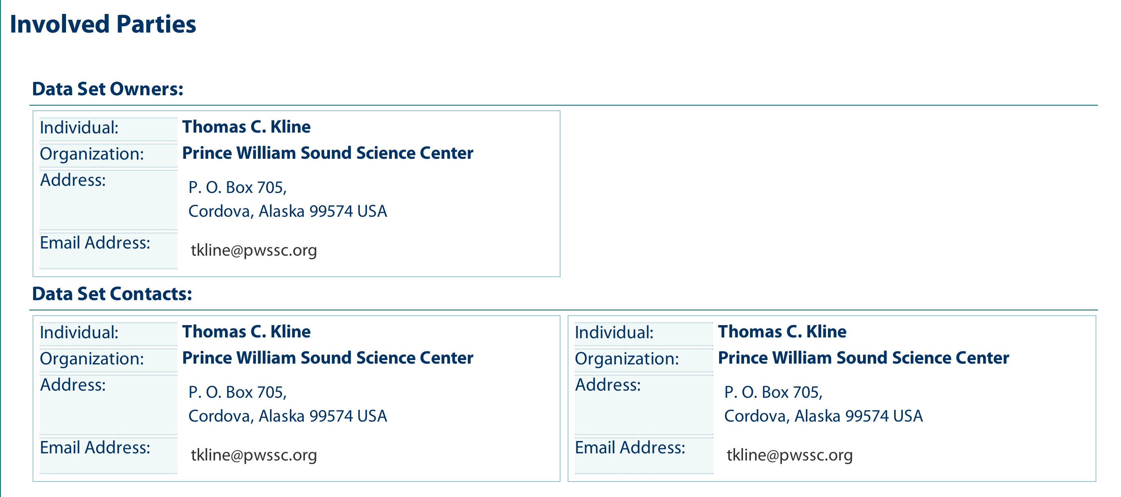
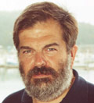
Owner and Contact Metadata

Slide 21
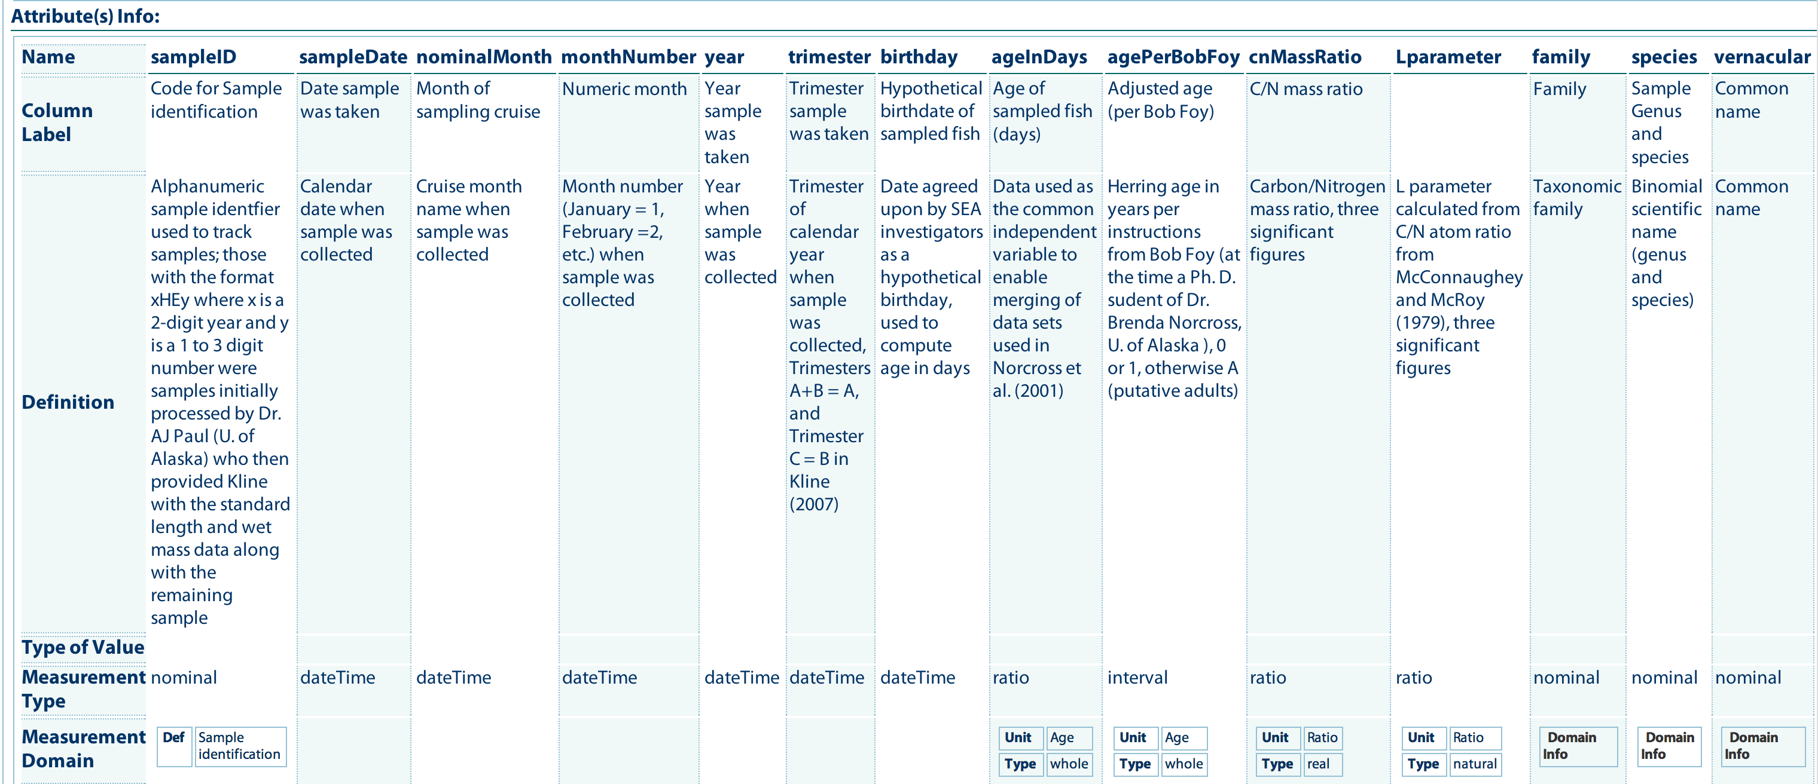
Column metadata

Slide 22
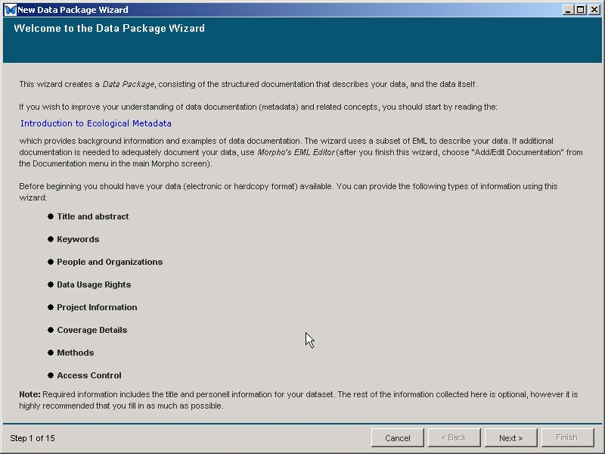

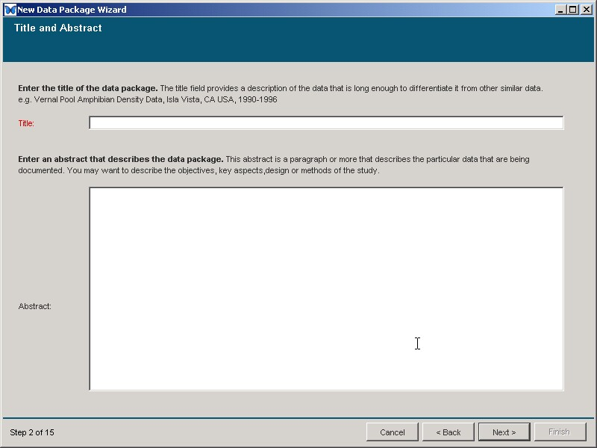
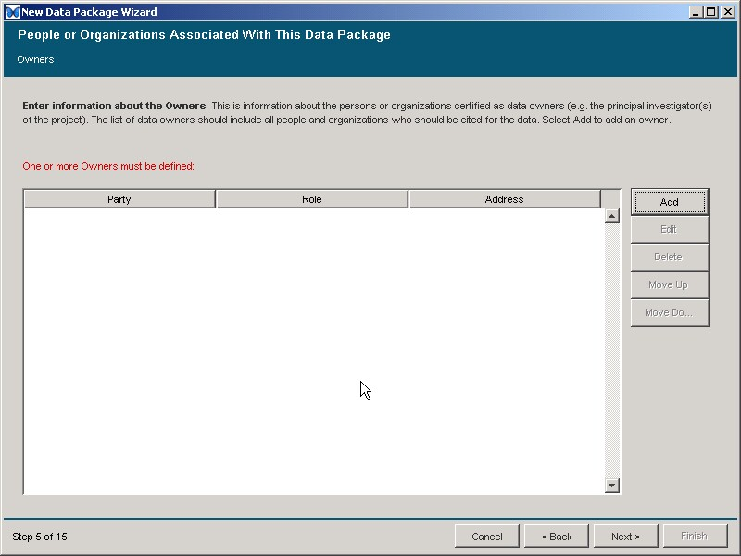
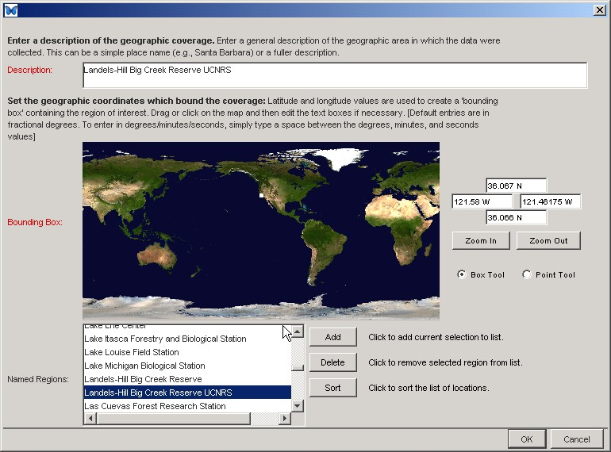
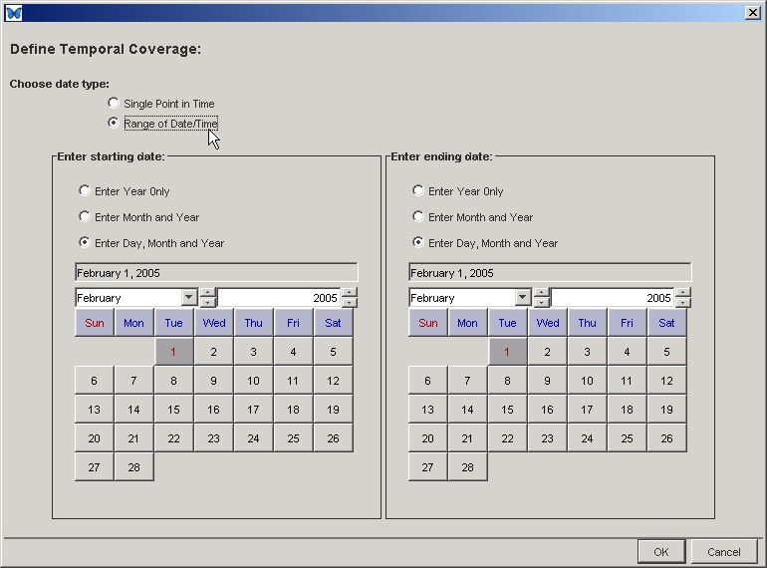
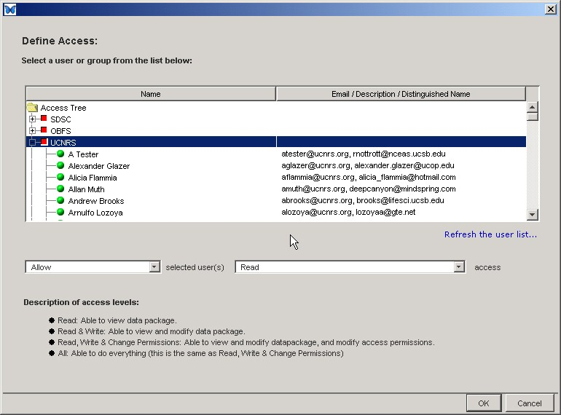
Wizard to create metadata
Morpho

Slide 23
Morpho highlights
Create metadata in EML format
Manage data in EML packages
Save, publish, and share data
Search for data
Multi-language
English, Spanish, Chinese, French, Portuguese, Japanese
Export data and metadata
Cross-platform, and open source
Morpho

Slide 24

Data Citation
NCEAS can issue DOI identifiers for publicly archived data sets:
doi://10.xxxx/AA/gulfwatch.9.15
Always resolve to the data set
Used in journals to cite data usage

Slide 25
CREATE NETWORKS

Slide 26
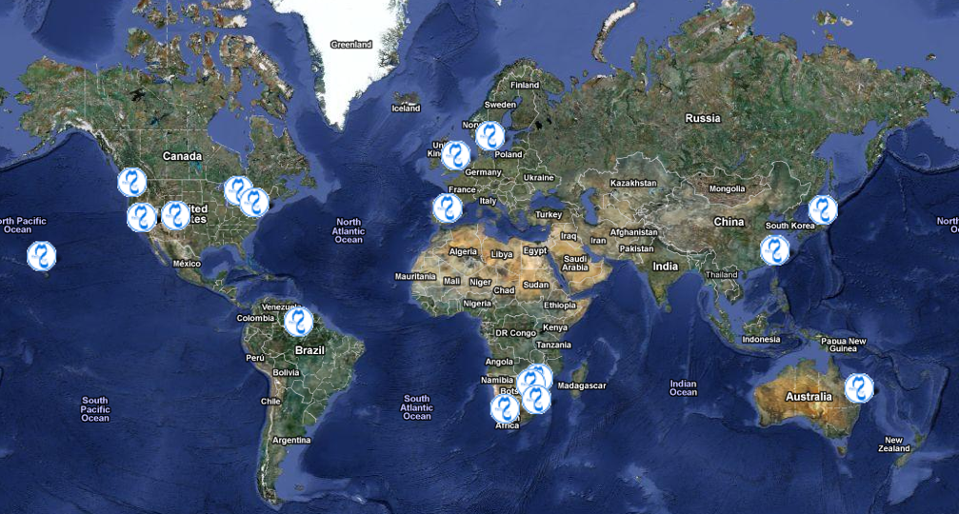
Global Metacat deployments

Slide 27
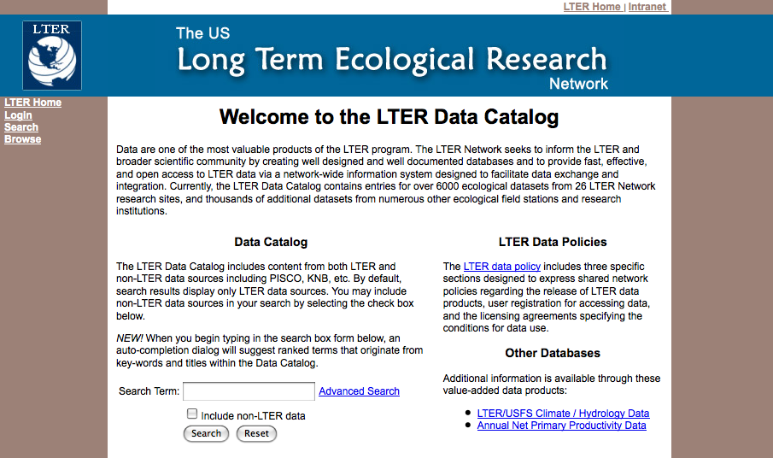
LTER Data Catalog
Notes:
This is the LTER skin for Metacat, showing the main search page.

Slide 28
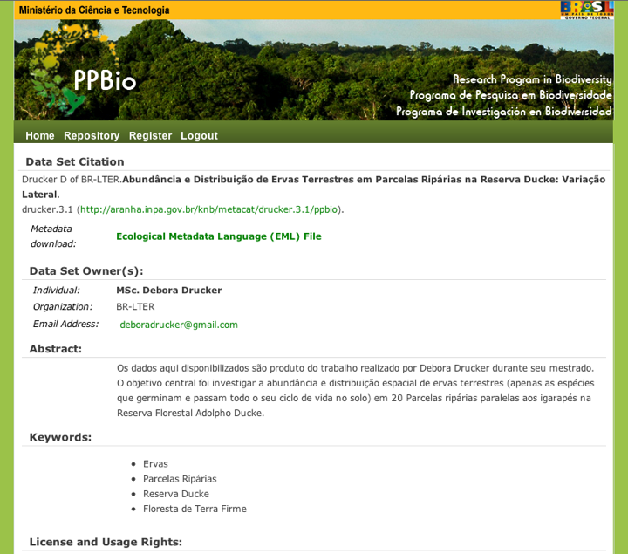
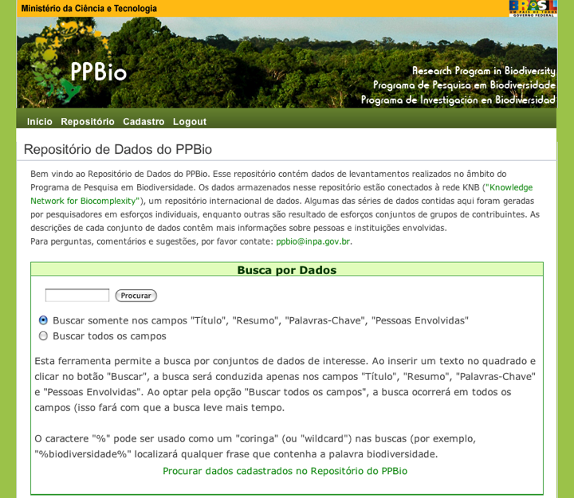
PPBio Data Catalog
Notes:
The PPBio Metacat skin in Portuguese, showing display of an EML document.

Slide 29
A Federation of repositories
Diverse Federation == Resilience
Failover for temporary outages
Insurance against project/institutional failure
Avoid correlated failures
Diverse Federation == Scalability
Storage increases with Member Nodes
Incremental costs to each MN to replicate
Distributes sustainability costs

Slide 30




Creating Interoperability
Member Nodes (MNs)
Heart of the federation
Harness the power of local curation
Coordinating Nodes (CNs)
Services to link Member Nodes
Investigator Toolkit (ITK)
Tools for the whole data lifecycle
Interoperability

Slide 31
Member Nodes
Authoritative members of the Federation
Curate data holdings
Provide unique identifiers for each object
Ensure availability, quality, and reliability
Replicate holdings for other MNs
Provide access and access control
Log and report accesses to objects
Engage with DataONE community
Deploy a DataONE-compatible software system

Slide 32







Member Nodes
Avian
Knowledge
Network

Slide 33
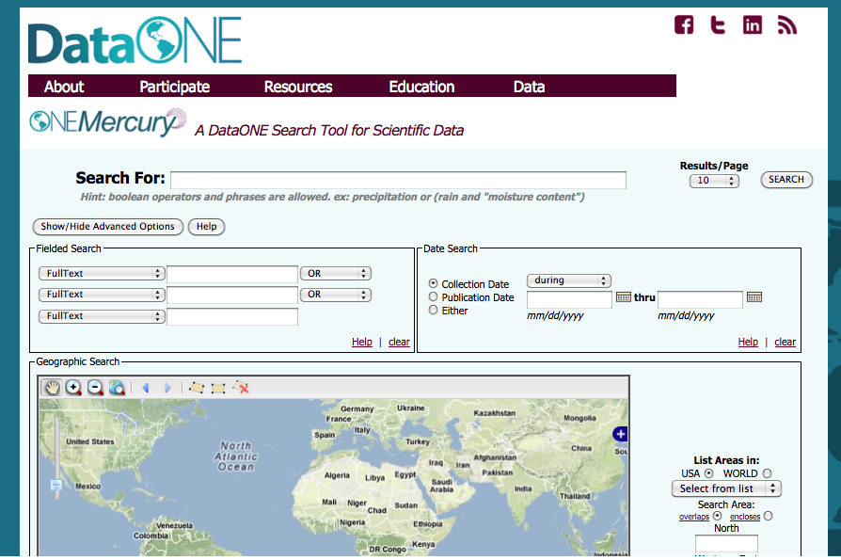

Slide 34
CREATE INTEROPERABLE SOFTWARE

Slide 35




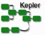










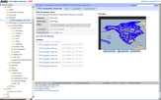

Software Interoperability
Assure
Plan
Discover
Integrate
Analyze
Collect
Describe
Preserve
DMP-Tool
Kepler
Notes:
Other development activities during years 2-5 will focus on expanding the suite of tools that are available through the Investigator Toolkit. New tool additions will be identified and prioritized by the DataONE Users Group.

Slide 36
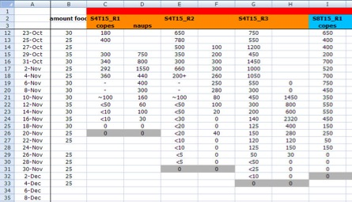



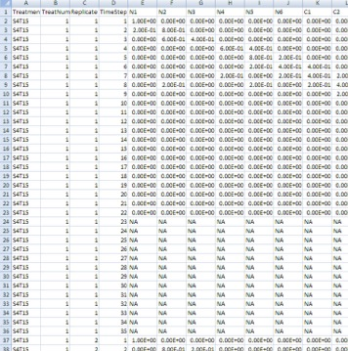
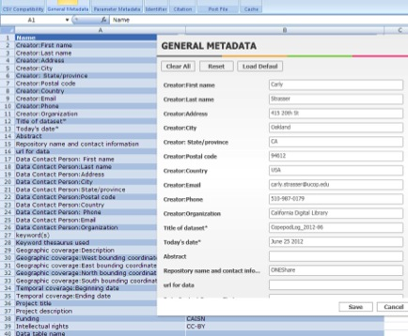
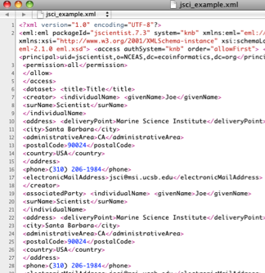
Check for best practices
Create metadata
Connect to ONEShare
Data &
Metadata (EML)

Slide 37


Data Flow and Replication
PARC
Member
NODC
USGS
KNB

Slide 38
How do we harness the long tail?
Efficient data federation
Focus on individual contributors
Late binding in informatics systems
Loose coupling
Schema-less storage
Central search for discovery
Interoperable software

Slide 39
Data Registration Activity
http://knb.ecoinformatics.org/knb/cgi-bin/register-dataset.cgi?cfg=knb

Slide 40
Questions?
Contact:
Matt Jones <jones@nceas.ucsb.edu>
Jim Regetz <regetz@nceas.ucsb.edu>
Links
http://www.nceas.ucsb.edu/ecoinfo/
http://knb.ecoinformatics.org/
http://dataone.org

